Slide 1


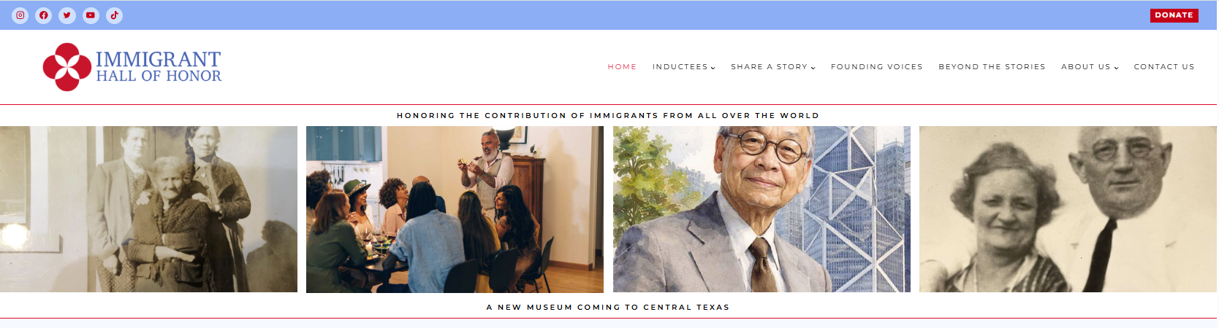
CHALLENGE X
Use Case
Creating Engaging and Interactive Content for a Virtual Museum
Project Sponsor: The Immigrant Hall of Honor

Slide 2
Problem Overview
IHH: A new non-profit needs to separate itself from the crowd.
Existing website (https://immigranthallofhonor.org) has relevant content, but not yet engaging.
Two primary components to our virtual museum:
          Public storytelling platform
          Profiles of current IHH inductees
    IHH Challenge X focus is on developing profile content for current inductees:
Madeline Albright | Irving Berlin | Celia Cruz | Albert Einstein | Bob Hope
Hedy Lamar | John Muir | James Naismith | I.M Pei | Levi Straus

Slide 3
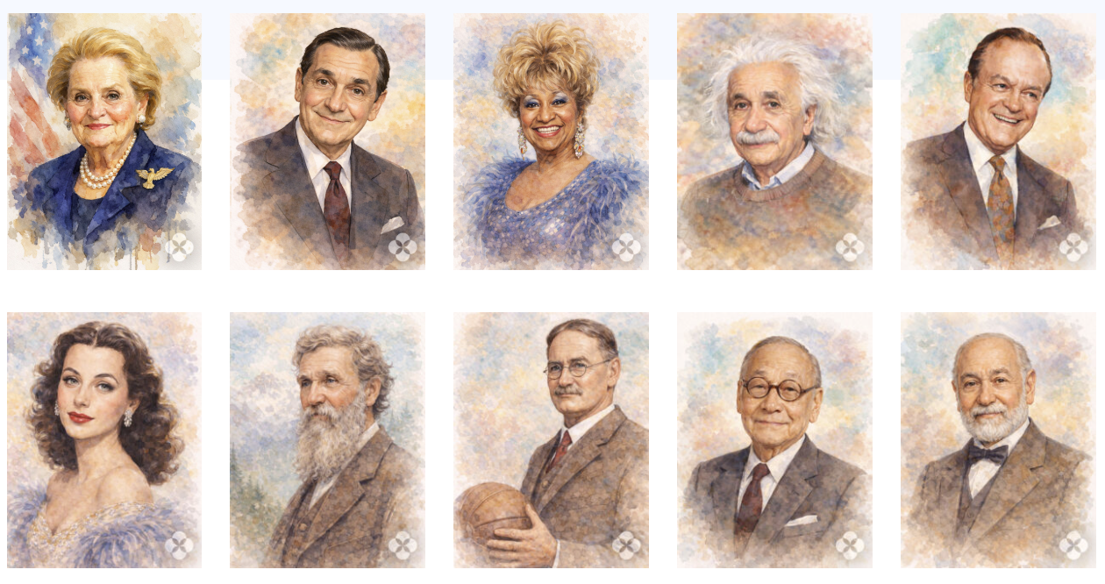
Your IHH Challenge
Choose at least four of our current inductees
Begin with existing IHH website content and increase depth with publicly available content
All content should be reliable and verifiable
Deliver content in a format that can be easily integrated into the existing web site
Goal: Enhance the existing IHH web with content that engage site visitors, especially young people
Madeline Albright | Irving Berlin | Celia Cruz | Albert Einstein | Bob Hope
Hedy Lamar | John Muir | James Naismith | I.M Pei | Levi Straus

Slide 4
Proposed Solution
You show us the solution!
Begin with existing content for each inductee
Conduct extensive and deep online research locating complementary multi-media resources
Ensure accuracy, accessibility, and open access of potential resources
Obtain appropriate resources
Transfer resources to IHH communications/website team

Slide 5
01
  Historical video and audio content of or about inductees
Possible Resource
Types
02
  Images of artifacts with AI generated annotation
03
  AI generated video and audio of or about inductees

Slide 6

Impact & Goals
  Play a critical role in IHH growth and mission
  Establish the IHH as a leader among virtual museums
  Develop UE skills in a real world environment
  Work with IHH communications/website team and leadership

Slide 7



Participant Incentives
$200 Honorarium per
successful profile
Introduction to and support from IHH team
Website presence & acknowledgement

